Slide 1



Basic Details Of The Problem Statement
Hackathon name : BFSI Launchpad 2025
Problem Statement Title: AI-Powered Insurance Policy Information Chatbot Participant Name: Arya Chatterjee
Institute Name: Meghnad Saha Institute of Technology
Theme Name: Smart Automation using AI in BFSI sector

Slide 2
Problem Statement Details
Background: Insurance companies offer a variety of policies, including health, life, auto, and home insurance. Customers often have questions about the different types of policies, coverage options, premiums, and claim processes. Providing timely and accurate information is crucial for customer satisfaction and decision-making. An AI-powered chatbot can assist customers by answering their queries about insurance policies, helping them understand their options and make informed decisions.
Objective: Develop a chatbot that can assist customers with queries related to different types of insurance policies offered by the company. The chatbot should understand natural language, provide accurate responses, and guide customers through the information they need.
Requirements:
LLM: Use LLM for natural language processing
Knowledge Base Integration: Create a knowledge base with information about different insurance policies, coverage options, premiums, and claim processes. Details can be shared in the form of PDF to create the knowledge base.
Data contextualization: Ensure the chatbot can retrieve and present relevant information from the knowledge base.
Conversation Management: Implement fallback mechanisms to escalate complex issues to human agents if necessary.
they need.
Current Status:
Working model is ready for demonstration , further build is on progress. Testing and validation process are next to be undergone.

Slide 3
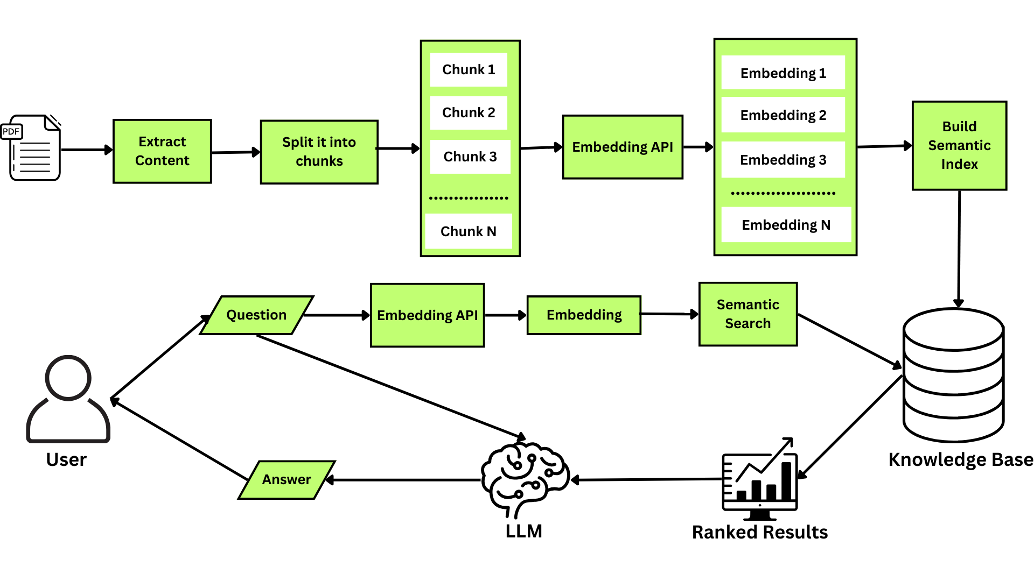
Idea/Approach Details
Idea/Solution/Prototype
Leverage opensource technology : To reduce development costs, and benefit from a wide range of freely available tools, libraries, and resources in building the chatbot.
Contextualized Conversation: We are creating NLP-driven chatbot with context management, intent recognition, and user engagement ensuring to the point answers.
Query Categorization: Categorize queries based on the type of information users seek (e.g., regulatory queries, land-related queries, safety compliance).
Retrieval-Augmented Generation (RAG):Incorporated a hybrid approach by combining semantic search with large language models. This ensures precise and grounded responses based on actual documents, reducing hallucinations from the LLM.5.
Fallback Mechanism with LLM: Integrated a smart fallback system that triggers a direct LLM response when the retrieval-based answer is vague or insufficient, ensuring that users always receive a meaningful and informative reply.
Technology stack :
Component | Tool / Library
Language | Python
PDF Processing | LangChain + PyPDFLoader
Chunking | RecursiveCharacterTextSplitter
Embeddings | GoogleGenerativeAIEmbeddings
Vector DB | FAISS
LLM | Gemini 2.0 Flash (Google)
UI | Command-line + IPython.display

Slide 4
Idea/Approach Details
Use Cases :
Dependencies / Show stopper :
General Purpose Usage: The chatbot can give answers about general knowledge questions accurately and with updated information.
Overcoming Language Barriers: A multilingual web based platform, based on 32 different languages, which will help our users to communicate with our chatbot .
Information Retrieval: The chatbot can provide up-to-date concise summaries of the relevant sections.
Natural Language Processing (NLP) Model Training: Training the NLP model to understand user intents, classify queries, and generate appropriate responses.
Data Availability and Quality: Availability of comprehensive and up-to-date information is difficult .
Hardware Limitations: Using advanced models(ChatGPT, LLama), to train or deploy requires heavy Computing power.
API Limitations: for deploying LLM models locally or in cloud we have to use API keys. Which can be prone to server errors and network issues.
Token Limit: There is token limitation in every model which affects the length and quality of the output produced.
Outcomes
Channels & Revenue Streams:
✅ Accurate policy information retrieval
✅ Robust fallback logic
✅ Efficient document handling with FAISS
✅ Ready for extension to Streamlit Web UI
Govt portals , Pvt industries, organizations etc.
Subscription Model, Pay-Per-Use, Enterprise Licensing.

Slide 5


